Slide 1



Netflix Data: Cleaning, Analysis and Visualization
By Himanshu Gautam
Linkedin
Github

Slide 2

Netflix is a streaming service that offers a wide selection of movies, TV shows, documentaries, anime, and more. It's available in many languages and in over 190 countries, with 283 million paid memberships as of December 2024
This project involves loading, cleaning, analyzing, and visualizing data from a Netflix dataset. We’ll use Structured Query Language (SQL) to write codes in MySQL Workbench and use Tableau to create charts and dashboards for data visualization.

Slide 3

Raw Data:
Click here to access the database
Netflix is a popular streaming service that offers a vast catalog of movies, TV shows, and original content.
This dataset is a cleaned version of the original version which can be found here
This dataset will be cleaned with MySQL and visualized with Tableau.
Data Collection Period:
The data consists of content added to Netflix from 2008 to 2021
The oldest content is as old as 1925 and the newest as 2021

Slide 4
Importing Data in MySQL and Data Manipulation:
Importing data from CSV file to MySQL workbench
Cleaning data to remove duplicates, missing values, and outliers
for accurate analysis.
Tasks:
Data Cleaning
Analysis
Visualization
Technologies used:
MySQL
Tableau

Slide 5
Creating Database and importing data in MySQL:
create database Netflix;
use Netflix;
CREATE TABLE mytable (
show_id VARCHAR(1024),
type VARCHAR(1024),
title VARCHAR(1024),
director VARCHAR(1024),
country VARCHAR(1024),
release_year BIGINT,
rating VARCHAR(1024),
duration VARCHAR(1024),
listed_in VARCHAR(1024)
);
INSERT INTO mytable
(show_id,type, title, director, country , release_year ,rating, duration, listed_in) VALUES(…..)

Slide 6
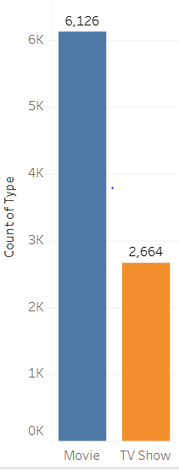
Content distribution on Netflix
SQL Code: use Netflix ;
select count(type) as total
from mytable ;
Total: 8790
SQL Code: use Netflix ;
select count(type) as total from mytable
where type = “Movie”;
Total: 6126
SQL Code: use Netflix ;
select count(type) as total from mytable
where type = “ TV Show;
Total: 2664

Slide 7
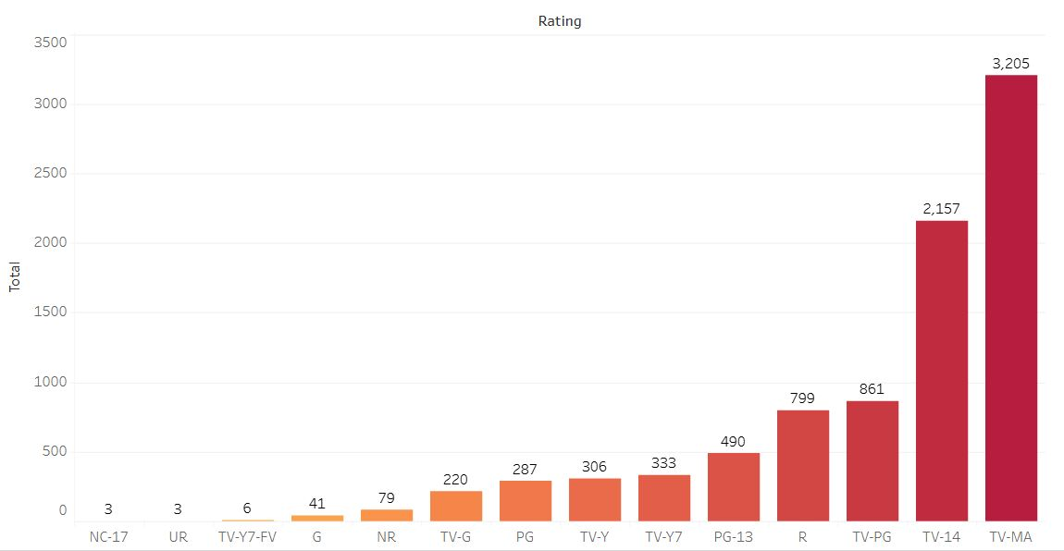
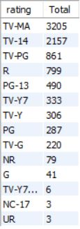
Rating on Netflix:
SQL Code: use Netflix;
select rating , count(type) as Total from mytable
group by rating
order by count(type) desc;

Slide 8
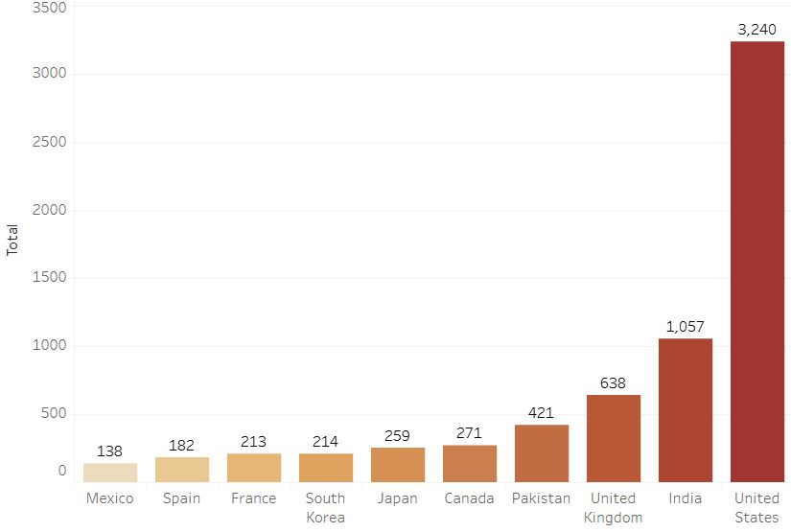
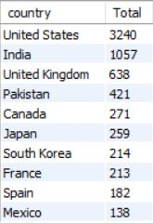
Top 10 countries with the most content on Netflix :
SQL Code: use Netflix;
select country , count(type) as Total from mytable
group by country
order by count(type) desc
limit 10;

Slide 9
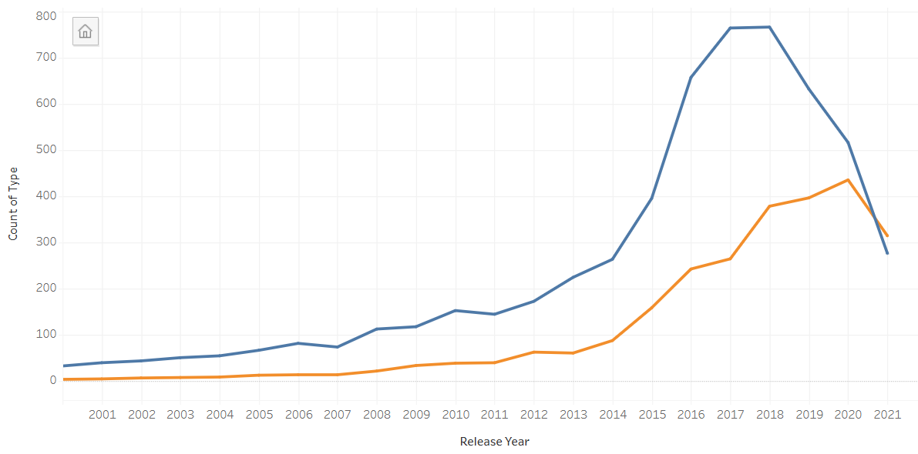
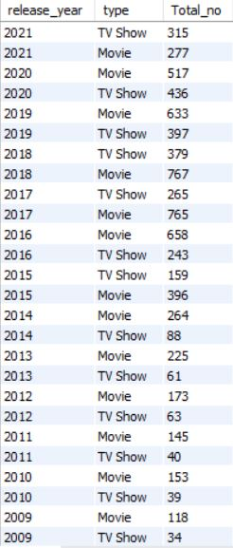
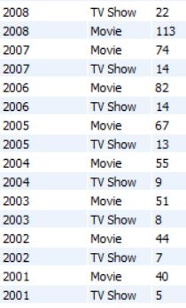
Yearly releases of Movies and TV Shows on Netflix:
SQL Code: use Netflix;
select release_year, type , count(type) as Total_no from mytable
where release_year >2000
group by type, release_year
order by release_year desc;
Movie
TV Show

Slide 10
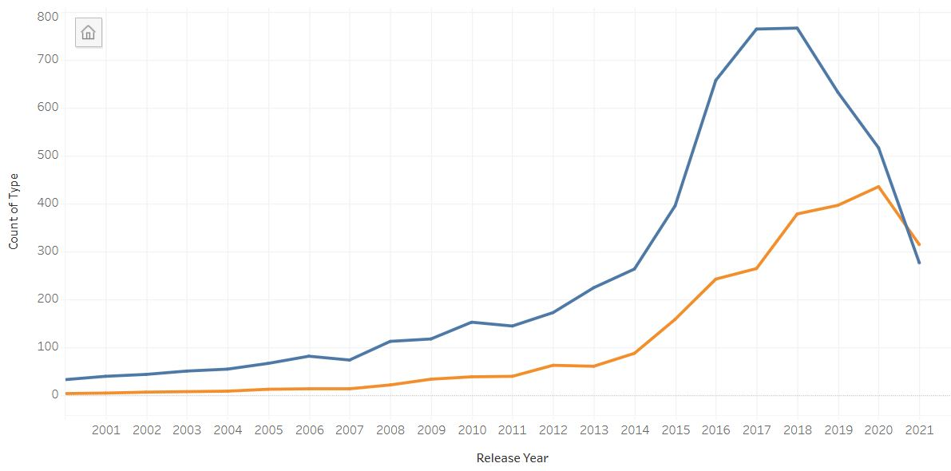
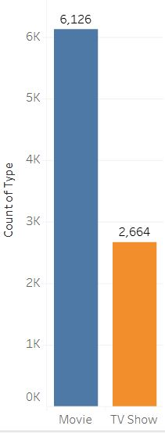
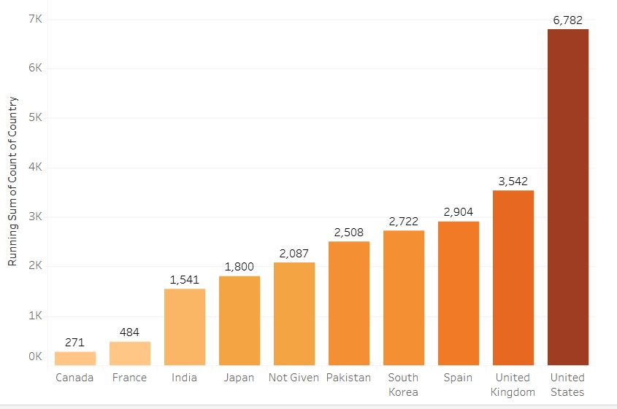
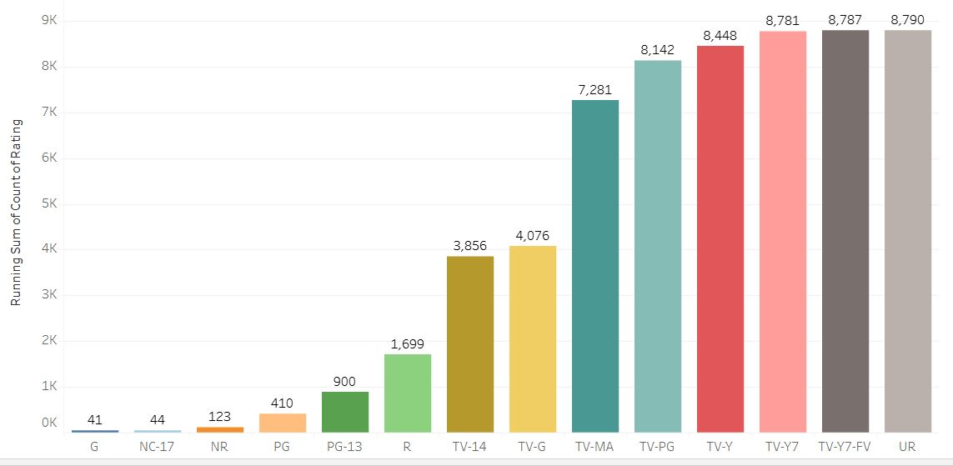
Netflix Tableau
Dashboard

Slide 11
Sample insights:
The majority of Netflix content is Movie, with a significant increase in Movie releases over the year
TV Shows are the second most common type of content, with a steady release pattern over the year
The top 5 ratings are TV-MA, TV-14, TV-PG, R, And PG-13
The Top 3 countries with the maximum viewership are the United States, India, and the United Kingdom
Maximum number of viewership likes to watch Movies over TV Shows
There is a clear trend of increasing content released over the years, with a significant spike in 2013

